Slide 1
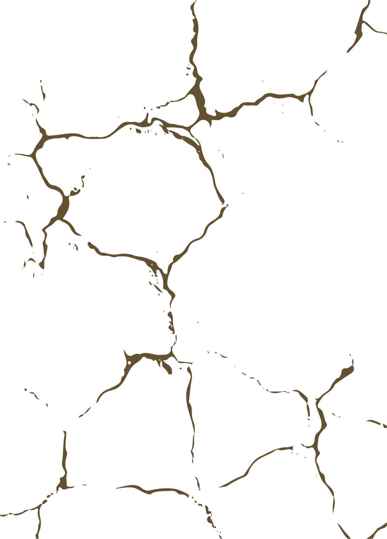
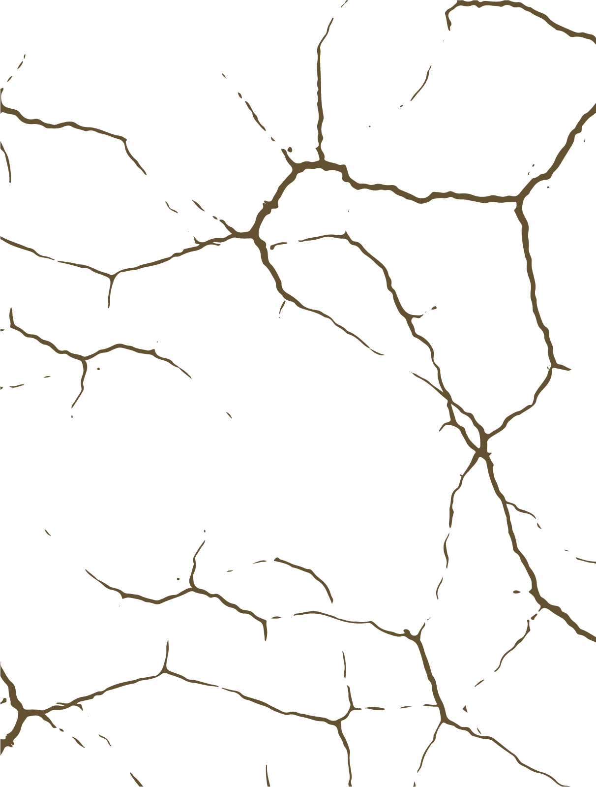

Largest Earthquakes 1937-2023
Netta Gemer

Slide 2
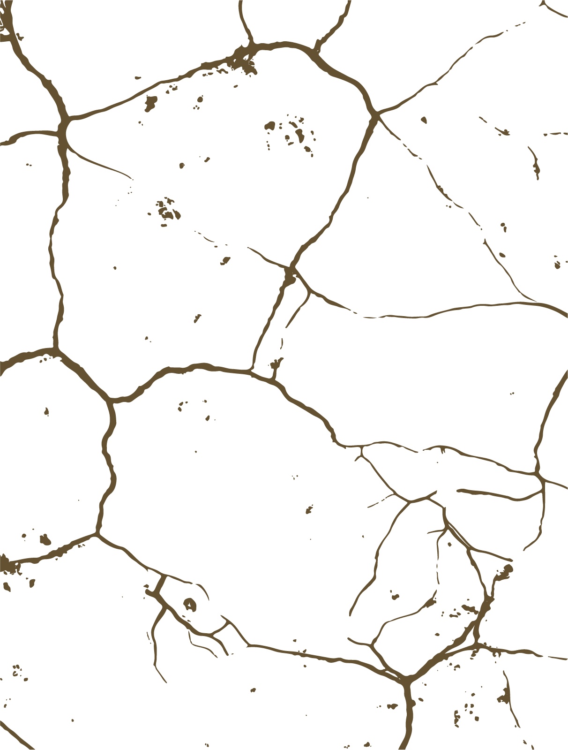
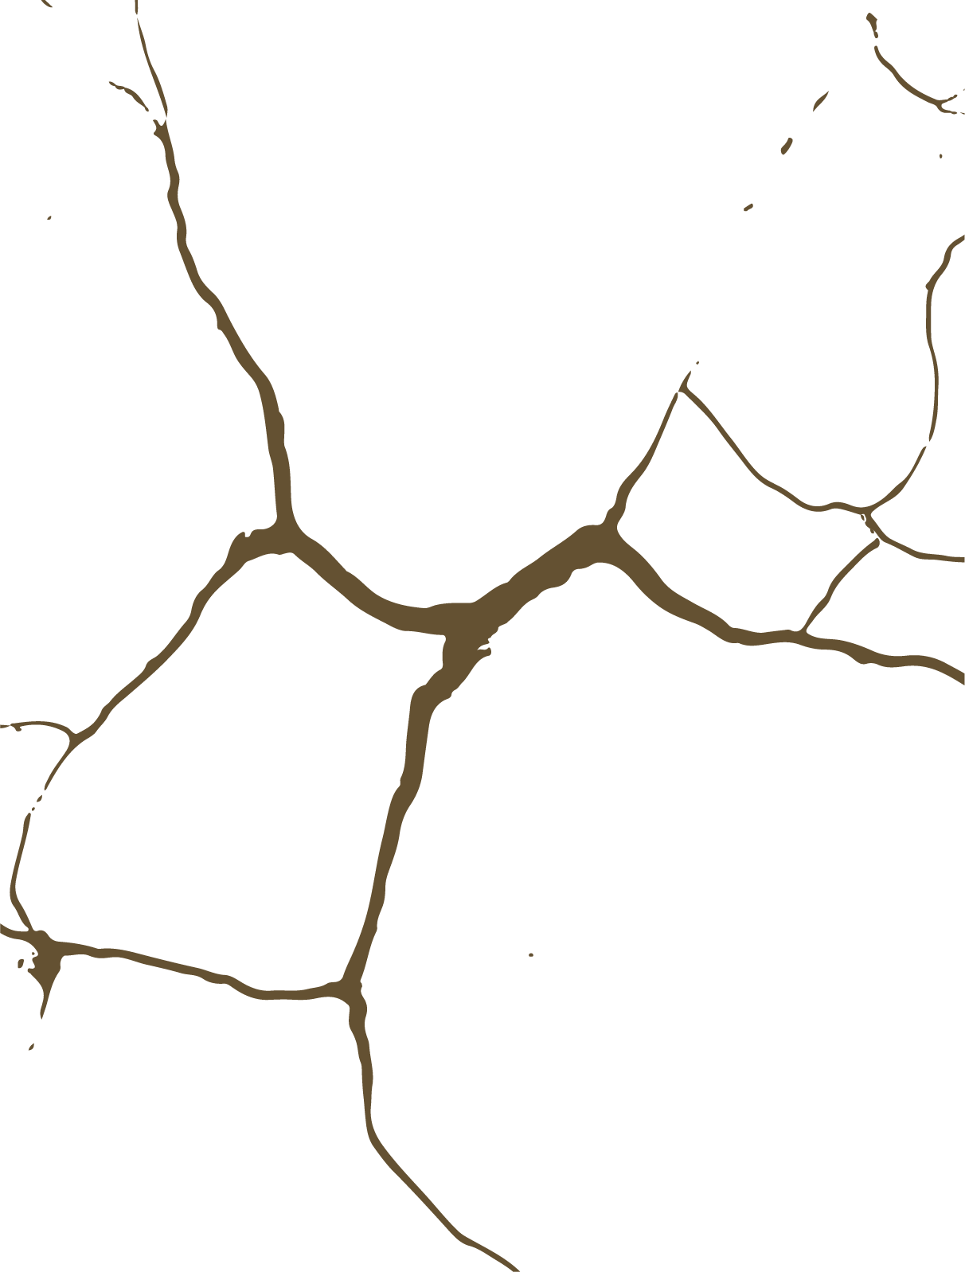
About Dataset
The data present the earthquake with the largest magnitude from year 1937 up to today.
The concepts relevant to the analysis I did are:
Magnitude- Magnitude is the size of the earthquake. An earthquake has a single magnitude.
Depth- the depth of focus or focal depth is the depth at which an earthquake occurs.
Location- I separated the column to country and place
MMI-The effect of an earthquake on the Earth's surface is called the intensity. This scale, composed of increasing levels of intensity that range from imperceptible shaking to catastrophic destruction, is designated by Roman numerals. It does not have a mathematical basis. instead it is an arbitrary ranking based on observed effects.

Slide 3
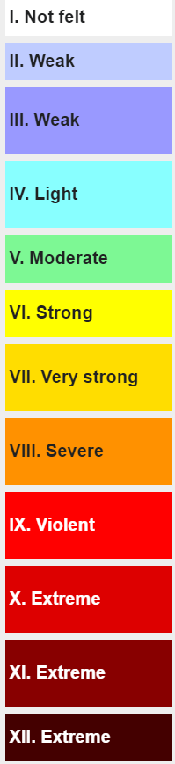
The Analysis
Frequency of Largest Earthquakes:
Peru and Japan emerge as the most seismically active countries, each experiencing 8 of the largest earthquakes from 1937 to 2023. This concentration of seismic events aligns with known seismic zones in South America and Asia.
Depth and MMI Relationship:
The second graph indicates a clear relationship between earthquake depth and MMI. As the depth of earthquakes decreases, the MMI tends to increase. This observation suggests that shallower earthquakes may have a more pronounced impact in terms of ground shaking and potential damage.

Slide 4
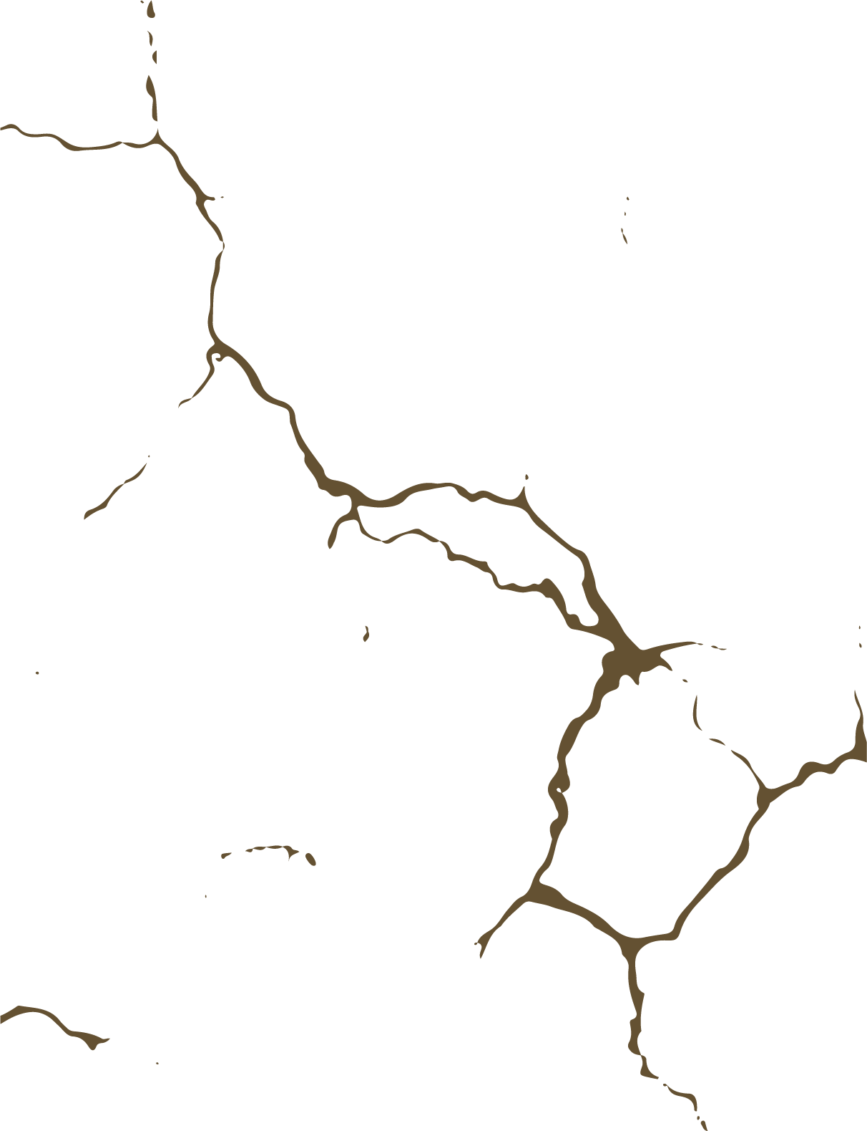
Amount Of Largest Earthquake Per Country
Peru and Japan stand out as having the highest frequency of earthquakes, each experiencing 8 earthquakes during the given period. This suggests that these countries are particularly seismically active.
The data shows a concentration of earthquake occurrences in specific regions, such as South America (Peru, Chile), Asia (Japan, Indonesia, Philippines), and the Pacific (Papua New Guinea, Solomon Islands, Samoa). This aligns with known seismic zones around the world.

Slide 5
Connection Between Depth and MMI
There seems to be an inverse relationship between MMI and earthquake depth. As MMI increases (from I to XII), the depth generally decreases. This suggests that shallower earthquakes are associated with higher intensities, reaching up to the highest MMI levels.
Earthquakes with lower MMI levels (I to V) seem to have a wider range of depths, while the depth values for higher MMI levels (VI to XII) are relatively clustered. This could imply that shallow earthquakes are more consistent in producing higher intensities.

Slide 6
Future Analysis
Adding a column of population so that I can check if indeed in places where there were many casualties/killed there was also a large settlement and vice versa.
Turning the Notes column into several columns through which additional analyzes will be performed: *Tsunami column where the values ​​will be yes/no. *A column of the height of the tsunami, if there was no value it would be empty.

